Slide 1
Line Follower Arduino
Enrique Rodríguez Villafranca
Mario Sanz González
Abraham López de Lerma

Slide 2

Index:
INTRODUCTION
01
COMPONENTS
02
MICROPROCESSOR
03
WORKING
PRINCIPLE
04
ECONOMIC IMPORTANCE
05

Slide 3
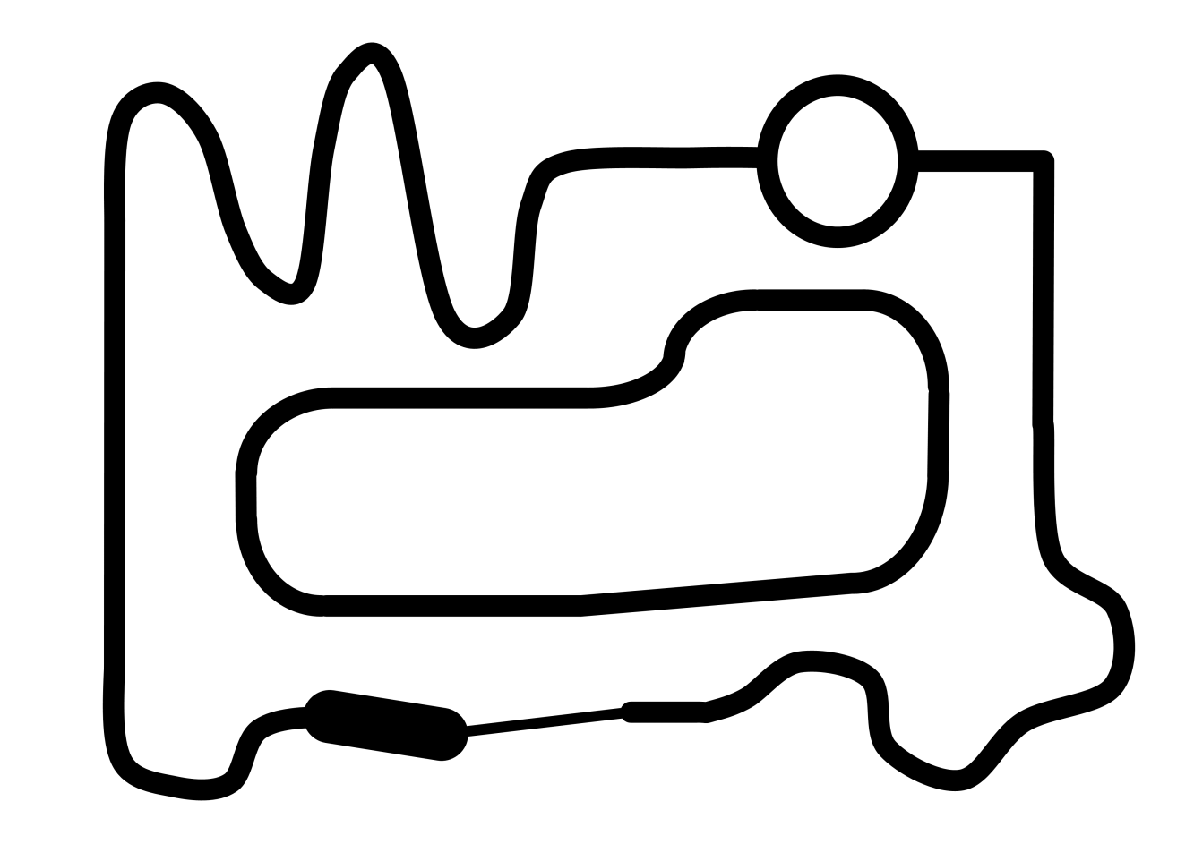

Introduction:
What’s a line follower?
Line follower is a machine that can follow a path. The path can be visible like a black line on a white surface (or vice-versa) or it can be invisible like a magnetic field.
In this case, it is able to follow a black line over a white surface:

Slide 4
What is the need to build a line follower?
Sensing a line and maneuvering the robot to stay on course, while constantly correcting wrong moves using feedback mechanism forms a simple yet effective closed loop system.

Slide 5
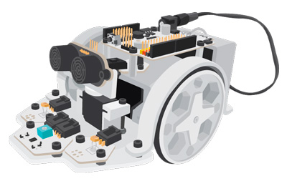
Components:
As mechanical structure, it has:
A methacrylate chassis on which the rest of the components are mounted.
Two wheels with independent servomotors to control the direction.
A battery compartment whose housing serves as the robot's third support point.
A support for mounting an ultrasonic sensor on a mini-servo.
As for sensors, it has several plates, called ZUMbloq, which incorporate:
2 infrared (IR) sensors, located in the front for the application of a robot follower.
2 light sensors type LDR, to follow or avoid sources of light.
1 ultrasonic sensor, to measure distances to objects and obstacles
As for the actuators, it has:
2 servomotors of continuous rotation, coupled to the 2 wheels to provide the traction and addressing.
1 180º servomotor to address the ultrasonic sensor.
1 buzzer to make sounds.

Slide 6
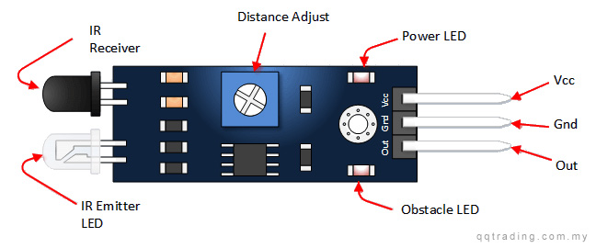
IR sensor
The infrared sensor consists of an emitting LED that emits infrared and a photodiode that captures the reflected signal.
This type of sensor allows to distinguish between a white or black surface according to the amount of reflected light .
WHITE LED is the emmiter, while BLACK Sensor is the receiver

Slide 7
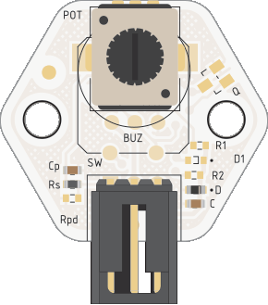
Buzzer
The buzzer is a type of actuator that allows you to generate sounds by usinga PWM output with which you can set the frequency of the sound to be generated.
We use the model Zum Bloq buzzer of BQ .
It will detect when the robot comes out of the line and Will make a BEEP kind of noise.
Voltage: 5V
Weight: 5gr
Input type; Digital (PWN)

Slide 8
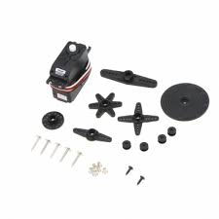
Servomotors:
Two rotating servomotors are used to move the robot.
They are able to regulate the speed and direction of rotation of each wheel independently.

Slide 9
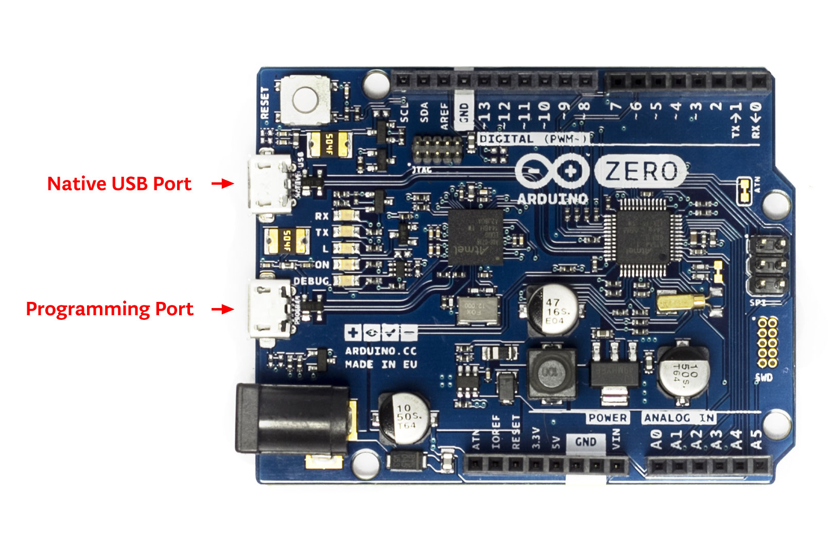
Microprocessor
SAMD21:
Arduino Zero board uses bossac and openOCD.
It has two USB ports that can be used for the programming of this plate.
Although both ports can be used for the programming of the board, the use of the programming port is preferred to that of the native port.
To use the programming port, it will be necessary to indicate in the Arduino IDE that will use that port.
Uses Von Neumann architecture (instruction data and program data are stored in the same memory)

Slide 10

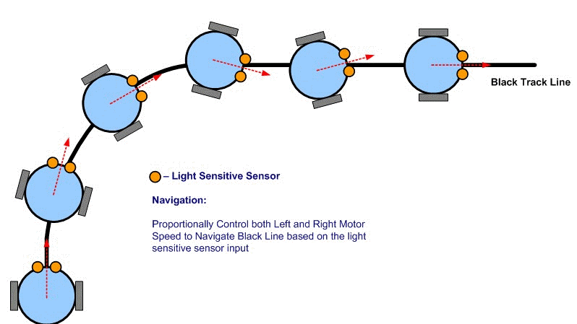
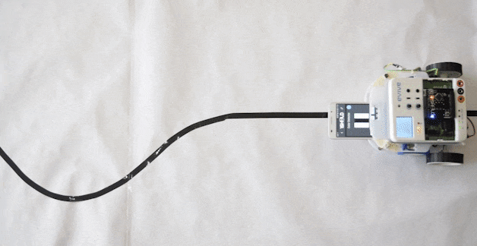

Working principle:
When a sensor is on the black line it reads 0 and when it is on the bright surface it reads 1.
1
When left sensor comes in white region then right motor stops while left motor continue to move so that right turn takes place and robot returns on white line.
2
First sensor which is to the right will become low as that sensor will be facing the black line and the remaining sensors response will be high.
3
When right sensor comes in white region then left motor stops while right motor continue to move so that left turn takes place and robot returns on white line.
When both sensors are on black line then robot moves forward.

Slide 11
